Slide 1
Chapter 3
Traditional
Symmetric-Key Ciphers
3.<number>

Slide 2
Chapter 3
Objectives
❏ To define the terms and the concepts of symmetric
key ciphers
❏ To emphasize the two categories of traditional
ciphers: substitution and transposition ciphers
❏ To describe the categories of cryptanalysis used to
break the symmetric ciphers
❏ To introduce the concepts of the stream ciphers and
block ciphers
❏ To discuss some very dominant ciphers used in the
past, such as the Enigma machine
3.<number>

Slide 3
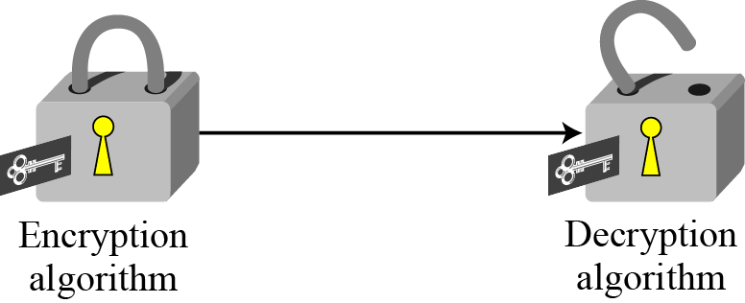
3.1 INTRODUCTION
Figure 3.2 Locking and unlocking with the same key
PLAINTEXT
PLAINTEXT
CIPHERTEXT
Alice
Bob
Eve
The Attacker
3.<number>

Slide 4
3-1 Continued
Components of Symmetric-key cipher:
The original message from Alice to Bob is called plaintext.
The message that is sent through the channel is called the ciphertext.
To create the ciphertext from the plaintext, Alice uses an encryption algorithm and a shared secret key.
To create the plaintext from ciphertext, Bob uses a decryption algorithm and the same secret key.
A shared secret key.
3.<number>

Slide 5
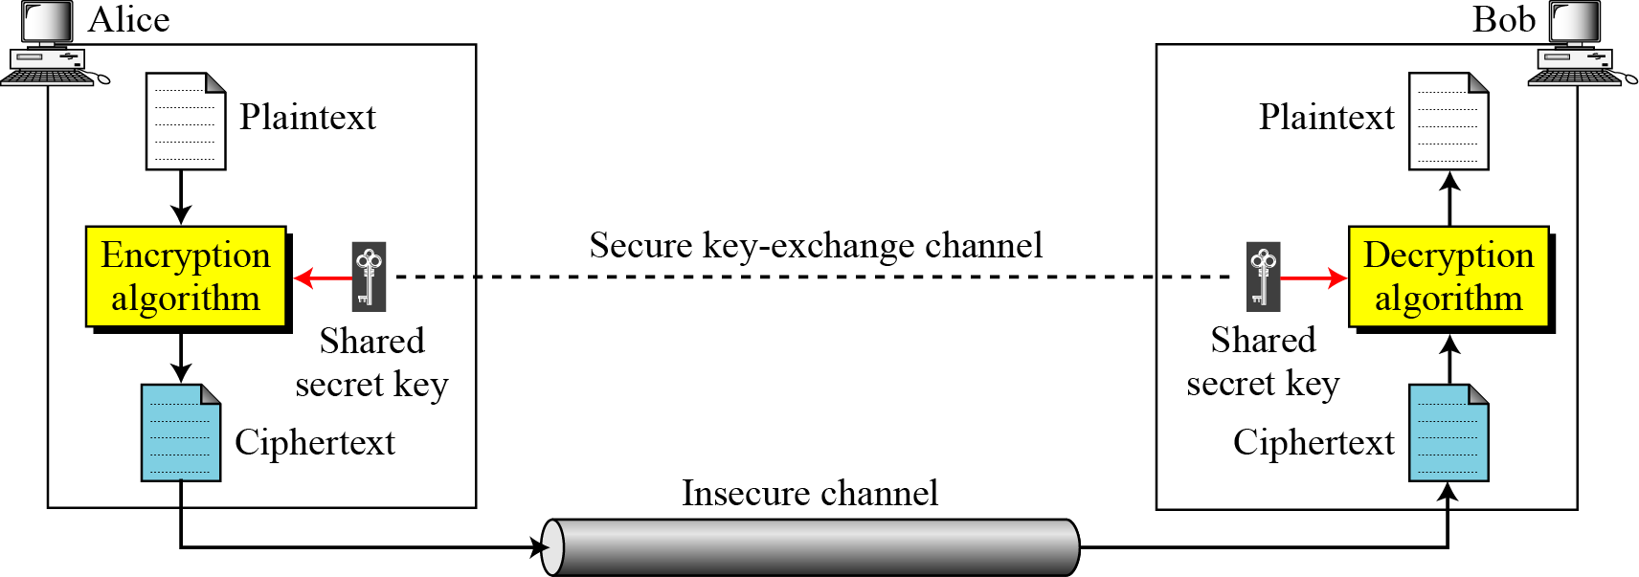
3.1 Continued
Figure 3.1 General idea of symmetric-key cipher
3.<number>

Slide 6
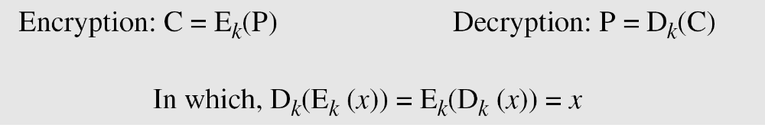
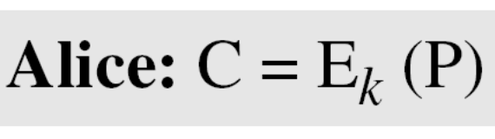
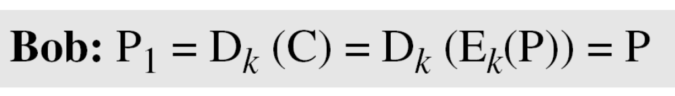
3.1 Continued
If P is the plaintext, C is the ciphertext, and K is the key,
We assume that Bob creates P₁; we prove that P₁ = P:
3.<number>

Slide 7
3.1.1 Kerckhoff’s Principle
Based on Kerckhoff’s principle, one should always assume that the adversary, Eve, knows the encryption/decryption algorithm.
The resistance of the cipher to attack must be based only on the secrecy of the key.
3.<number>

Slide 8
3.1.2 Cryptanalysis
cryptography is the science and art of creating secret codes,
cryptanalysis is the science and art of breaking those codes.
Cryptanalysis attacks
Statistical Attack : requires some statistical knowledge of the plaintext / language.
Brute-force Attack : try every possible keys.
3.<number>

Slide 9
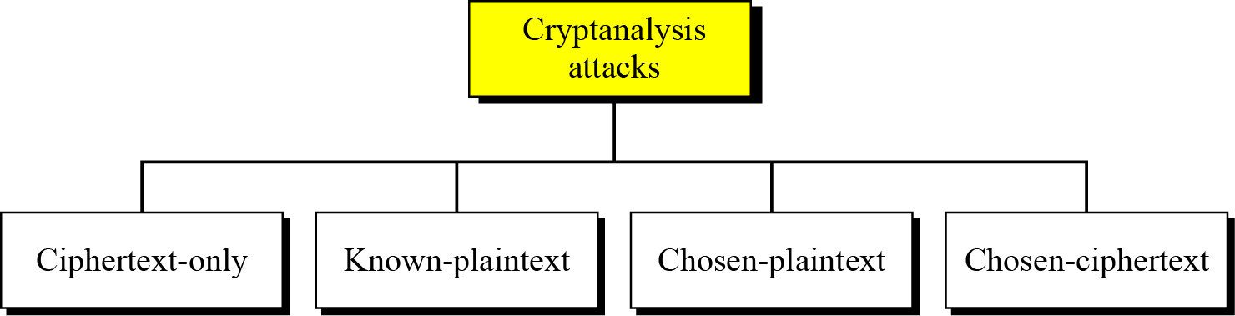
3.1.2 Cryptanalysis
Figure 3.3 Cryptanalysis attacks
3.<number>

Slide 10
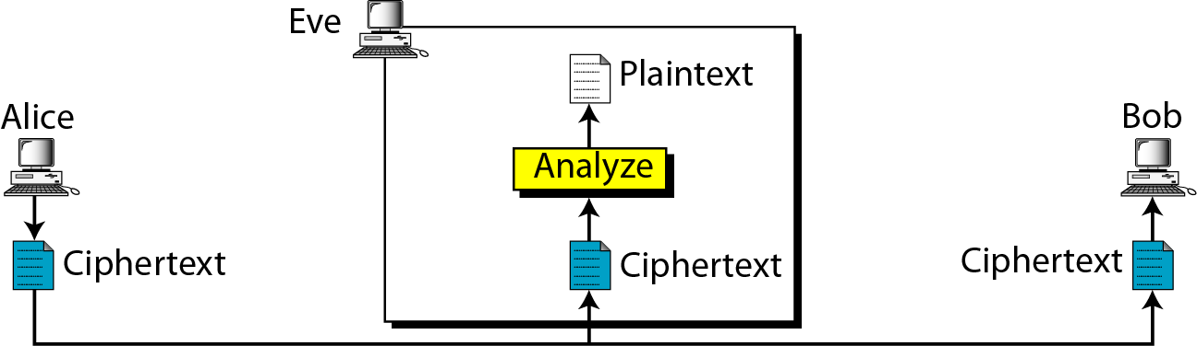
3.1.2 Continued
Ciphertext-Only Attack
Figure 3.4 Ciphertext-only attack
Known: only some ciphertext
Find: the key and the plaintext
CT=UFYU , PT=?
Ans=TEXT
3.<number>

Slide 11
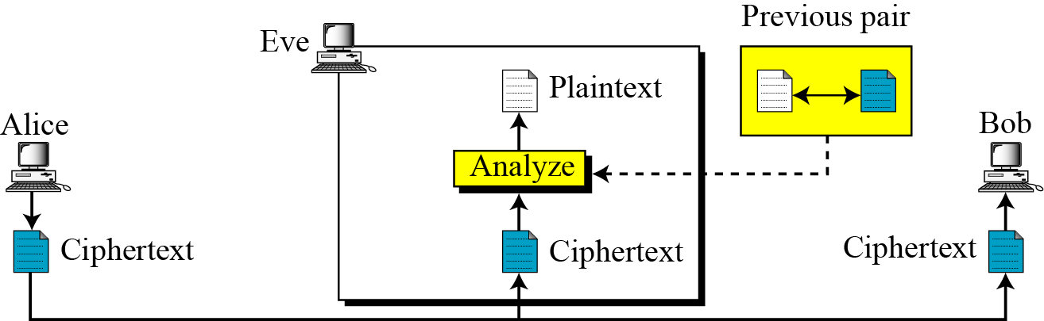
3.1.2 Continued
Known-Plaintext Attack
Figure 3.5 Known-plaintext attack
Known: a pair of plaintext-ciphertext and the intercepted ciphertext.
Find: the key and the plaintext
Ex: As SERUTAERC is to creatures so is ENOHPELET is to _________?
3.<number>

Slide 12
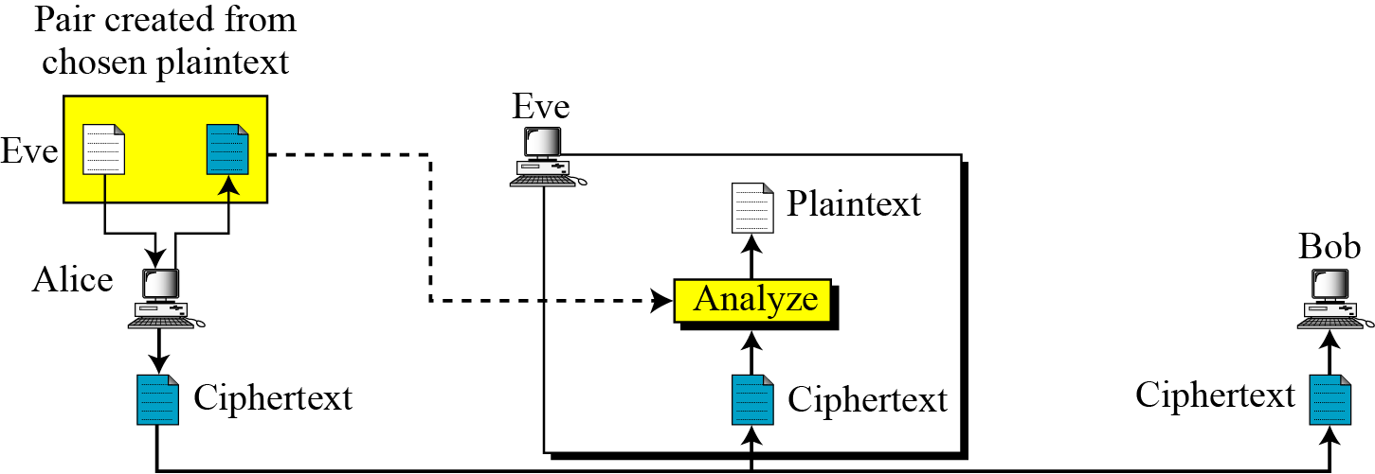
3.1.2 Continued
Chosen-Plaintext Attack
(similar to Known-Plaintext Attack)
Known: a pair of plaintext-ciphertext but chosen by attacker herself and the intercepted ciphertext.
Find: the key and the plaintext
* Eve might have access to Alice’s computer.
Ex:If PT=PEREGRINATION and the CT=1232435678596
Given CT=244 PT=?
3.<number>

Slide 13
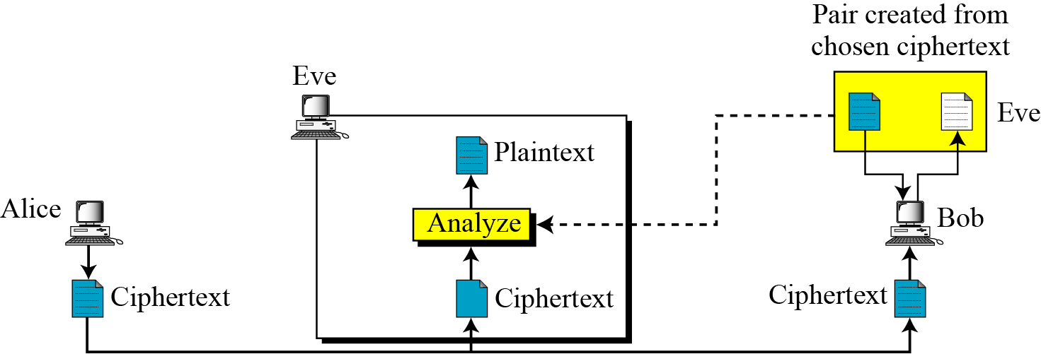
3.1.2 Continued
Chosen-Ciphertext Attack
Known: a pair of plaintext-ciphertext but chosen by attacker herself and the intercepted ciphertext.
Find: the key and the plaintext
Eve might have access to Bob’s computer.
3.<number>

Slide 14

3-2 SUBSTITUTION CIPHERS
A substitution cipher replaces one symbol with another. Substitution ciphers can be categorized as either monoalphabetic ciphers or polyalphabetic ciphers.
Note
A substitution cipher replaces one symbol with another.
Topics discussed in this section:
3.2.1 Monoalphabetic Ciphres
3.2.2 Polyalphabetic Ciphers
3.<number>

Slide 15
3.2.1 Monoalphabetic Ciphers
Note
In monoalphabetic substitution, the relationship between a symbol in the plaintext to a symbol in the ciphertext is always one-to-one.
3.<number>

Slide 16
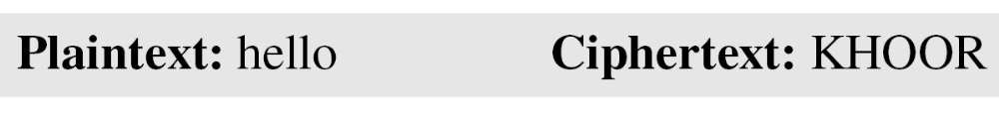
3.2.1 Continued
Example 3.1
The following shows a plaintext and its corresponding ciphertext. The cipher is probably monoalphabetic because both l’s (els) are encrypted as O’s.
Example 3.2
The following shows a plaintext and its corresponding ciphertext. The cipher is not monoalphabetic because each l (el) is encrypted by a different character.
ABNZF
3.<number>

Slide 17
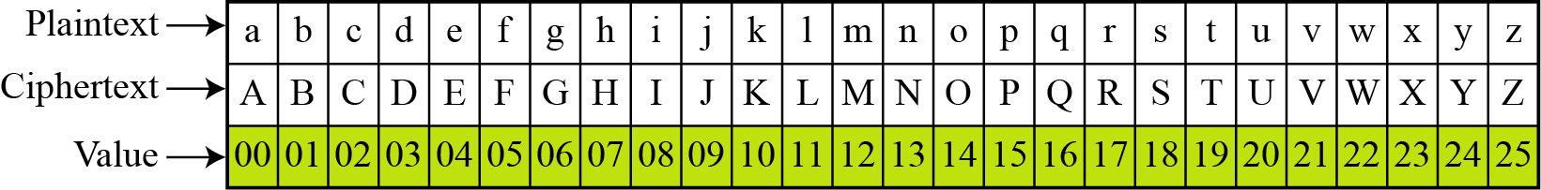
(Caesar cipher)
Additive Cipher
The simplest monoalphabetic cipher is the additive cipher.
This cipher is sometimes called a shift cipher and sometimes a Caesar cipher, but the term additive cipher better reveals its mathematical nature.
Figure 3.8 Plaintext and ciphertext in Z₂₆
3.<number>

Slide 18
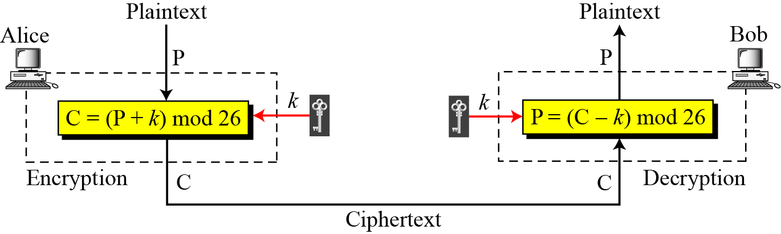
3.2.1 Continued
Figure 3.9 Additive cipher
Note
When the cipher is additive, the plaintext, ciphertext, and key are integers in Z₂₆.
3.<number>

Slide 19
Modular Arithmatic
Modular Arithmatic
In integer arithmetic,
if we divide a by n, we can get q and r .
The relationship between these four integers can be shown as
a = q * n + r a mod n = r
11 mod 7 = 4
a = 11 n= 7
11=1 x 7 + 4
-11 mod 7= ?
-11= -2 x7 +3
-5 mod 2 = ?
3
3.<number>

Slide 20
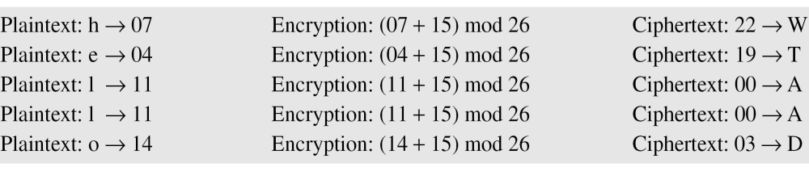
3.2.1 Continued
Example 3.3
Use the additive cipher with key = 15 to encrypt the message “hello”.
Solution
We apply the encryption algorithm to the plaintext, character by character:
3.<number>

Slide 21
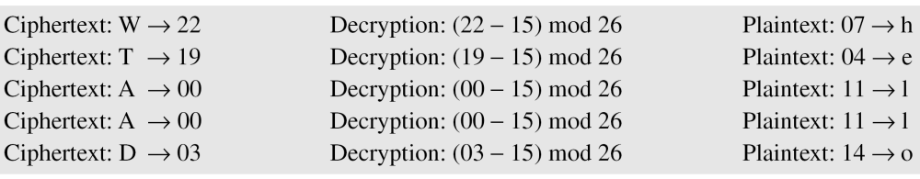
3.2.1 Continued
Example 3.4
Use the additive cipher with key = 15 to decrypt the message “WTAAD”.
Solution
We apply the decryption algorithm to the plaintext character by character:
3.<number>

Slide 22
3.2.1 Continued
Shift Cipher and Caesar Cipher
Historically, additive ciphers are called shift ciphers.
Julius Caesar used an additive cipher to communicate with his officers. For this reason, additive ciphers are sometimes referred to as the Caesar cipher.
Caesar used a key of 3 for his communications.
Note
Additive ciphers are sometimes referred to as shift ciphers or Caesar cipher.
3.<number>

Slide 23
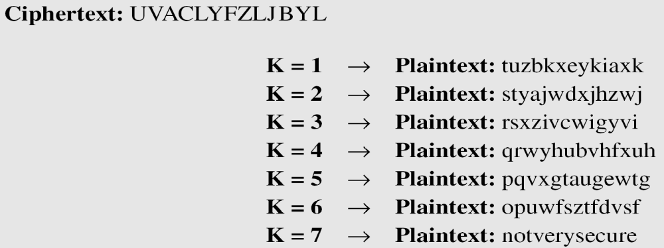
3.2.1 Continued
Example 3.5
Eve has intercepted the ciphertext “UVACLYFZLJBYL”. Show how she can use a brute-force attack to break the cipher.
Solution
Eve tries keys from 1 to 7.
With a key of 7, the plaintext is “not very secure”, which makes sense.
3.<number>

Slide 24
Cryptanalysis of Caesar Cipher
only have 26 possible ciphers
  A maps to A,B,..Z
could simply try each in turn
a brute force search
given ciphertext, just try all shifts of letters
do need to recognize when have plaintext
eg. break the ciphertext "GCUA VQ DTGCM“
Ans: P.T.- easy to break (key=2)
3.<number>

Slide 25
Continued…
rather than just shifting the alphabet
could shuffle (jumble) the letters arbitrarily
each plaintext letter maps to a different random ciphertext letter
hence key is 26 letters long
  Plain: abcdefghijklmnopqrstuvwxyz
  ...
  Cipher: DKVQFIBJWPESCXHTMYAUOLRGZN
  Plaintext: ifwewishtoreplaceletters
  Ciphertext: WIRFRWAJUHYFTSDVFSFUUFYA
3.<number>

Slide 26
Continued…
now have a total of 26! = 4 x 10²⁶ keys
with so many keys, might think is secure
but would be !!!WRONG!!!
The problem is language characteristics
human languages are redundant
  in English e is by far the most common letter
then T,R,N,I,O,A,S
3.<number>

Slide 27
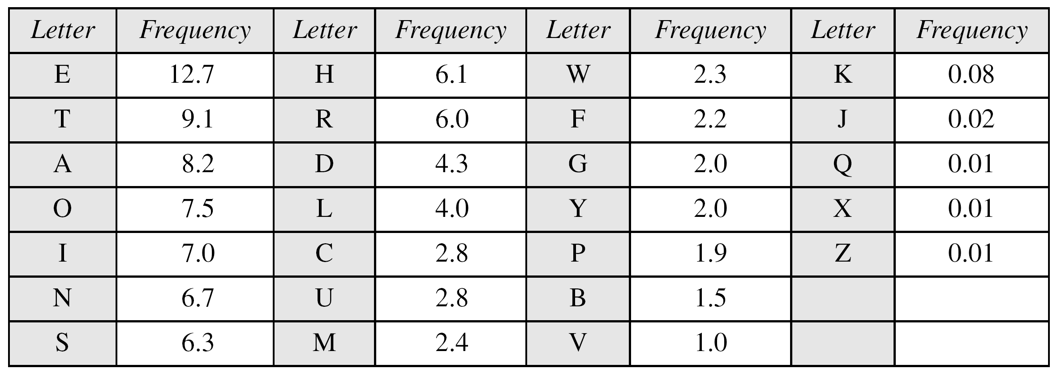
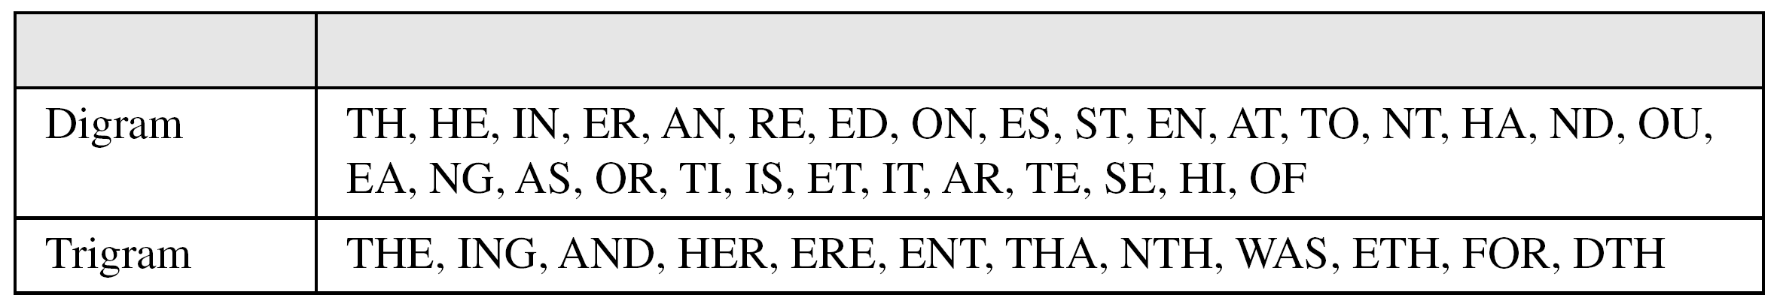
3.2.1 Continued
Table 3.1 Frequency of characters in English
Table 3.2 Frequency of diagrams and trigrams
3.<number>

Slide 28
3.2.1 Continued
Example 3.6
Eve has intercepted the following ciphertext. Using a statistical attack, find the plaintext.
Solution
When Eve tabulates the frequency of letters in this ciphertext, she gets: I =14, V =13, S =12, and so on. The most common character is I with 14 occurrences. This means key = 4.
3.<number>

Slide 29
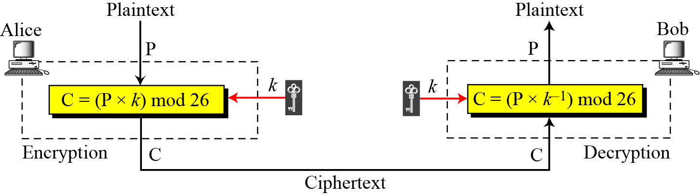
3.2.1 Continued
Multiplicative Ciphers
Figure 3.10 Multiplicative cipher
Note
In a multiplicative cipher, the plaintext and ciphertext are integers in Z₂₆; the key is an integer in Z26*.
3.<number>

Slide 30
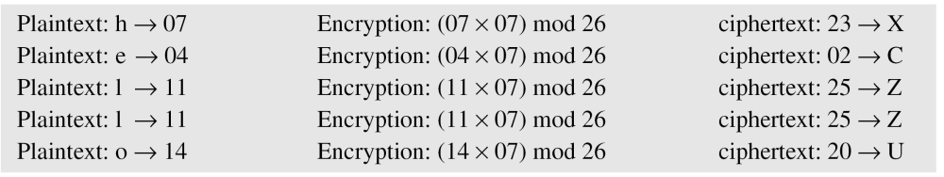
3.2.1 Continued
Example 3.7
What is the key domain for any multiplicative cipher?
Solution
The key needs to be in Z₂₆*. This set has only 12 members: 1, 3, 5, 7, 9, 11, 15, 17, 19, 21, 23, 25.
Example 3.8
We use a multiplicative cipher to encrypt the message “hello” with a key of 7. The ciphertext is “XCZZU”.
For Decryption use the multiplicative inverse modulo of 7 i.e. 7⁻¹= 15
3.<number>

Slide 31
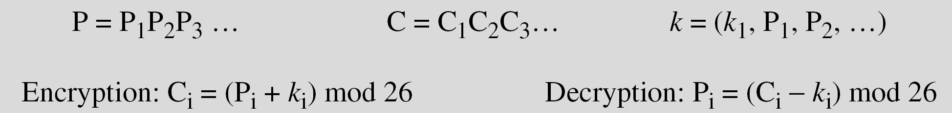
3.2.2 Polyalphabetic Ciphers
In polyalphabetic substitution, each occurrence of a character may have a different substitute. The relationship between a character in the plaintext to a character in the ciphertext is one-to-many.
Autokey Cipher
3.<number>

Slide 32
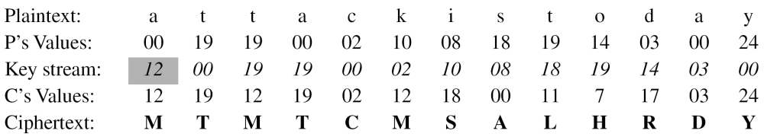
3.2.2 Continued
Example 3.14
Assume that Alice and Bob agreed to use an autokey cipher with initial key value k1 = 12. Now Alice wants to send Bob the message “Attack is today”. Enciphering is done character by character.
3.<number>

Slide 33
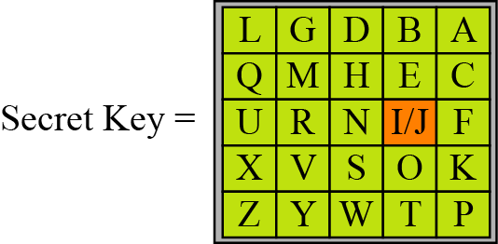
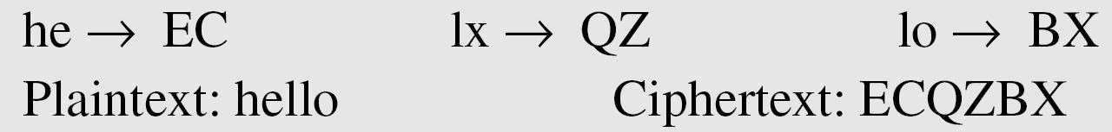
3.2.2 Continued
Playfair Cipher
Figure 3.13 An example of a secret key in the Playfair cipher
Example 3.15
Let us encrypt the plaintext “hello” using the key in Figure 3.13.
3.<number>

Slide 34
3.2.2
Playfair Cipher:
a 5X5 matrix of letters based on a keyword
fill in letters of keyword (sans duplicates)
fill rest of matrix with other letters
eg. using the keyword COMPATIBLE.
C | O | M | P | A
T | I/J | B | L | E
D | F | G | H | K
N | Q | R | S | U
V | W | X | Y | Z
3.<number>

Slide 35
Encrypting and Decrypting
plaintext encrypted two letters at a time:
  if a pair is a repeated letter, insert a filler like 'X', eg. "balloon" encrypts as "ba lx lo on"
  if both letters fall in the same row, replace each with letter to right (wrapping back to start from end), eg. “ar" encrypts as "RM"
  if both letters fall in the same column, replace each with the letter below it (again wrapping to top from bottom), eg. “mu" encrypts to "CM"
  otherwise each letter is replaced by the one in its row in the column of the other letter of the pair, eg. “hs" encrypts to "BP", and “ea" to "IM" or "JM" (as desired)
3.<number>

Slide 36
Ex:
s | i/j | m | p | l
e | a | b | c | d
f | g | h | k | n
o | q | r | t | u
v | w | x | y | z
Given keyword
“simple”
PT=Balloon, CT= ??
PT- we are discovered save yourself
CT- vabqaemietsfobelewcvqoomdshv
3.<number>

Slide 37
Security of the Playfair Cipher
security much improved over monoalphabetic
since have 26 x 26 = 676 digrams
would need a 676 entry frequency table to analyse (verses 26 for a monoalphabetic)
and correspondingly more ciphertext
was widely used for many years (eg. US & British military in WW1)
it can be broken, given a few hundred letters
since still has much of plaintext structure
3.<number>

Slide 38
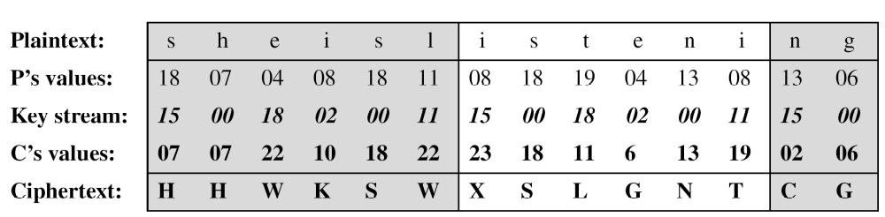
3.2.2 Continued
Vigenere Cipher
Example 3.16
We can encrypt the message “She is listening” using the
6-character keyword “PASCAL”.
3.<number>

Slide 39
3.2.2 Continued
Example 3.16
Let us see how we can encrypt the message “She is listening” using the 6-character keyword “PASCAL”.
The initial key stream is (15, 0, 18, 2, 0, 11).
The key stream is the repetition of this initial key stream (as many times as needed).
i.e. P A S C A L
15, 0, 18, 2, 0, 11
3.<number>

Slide 40
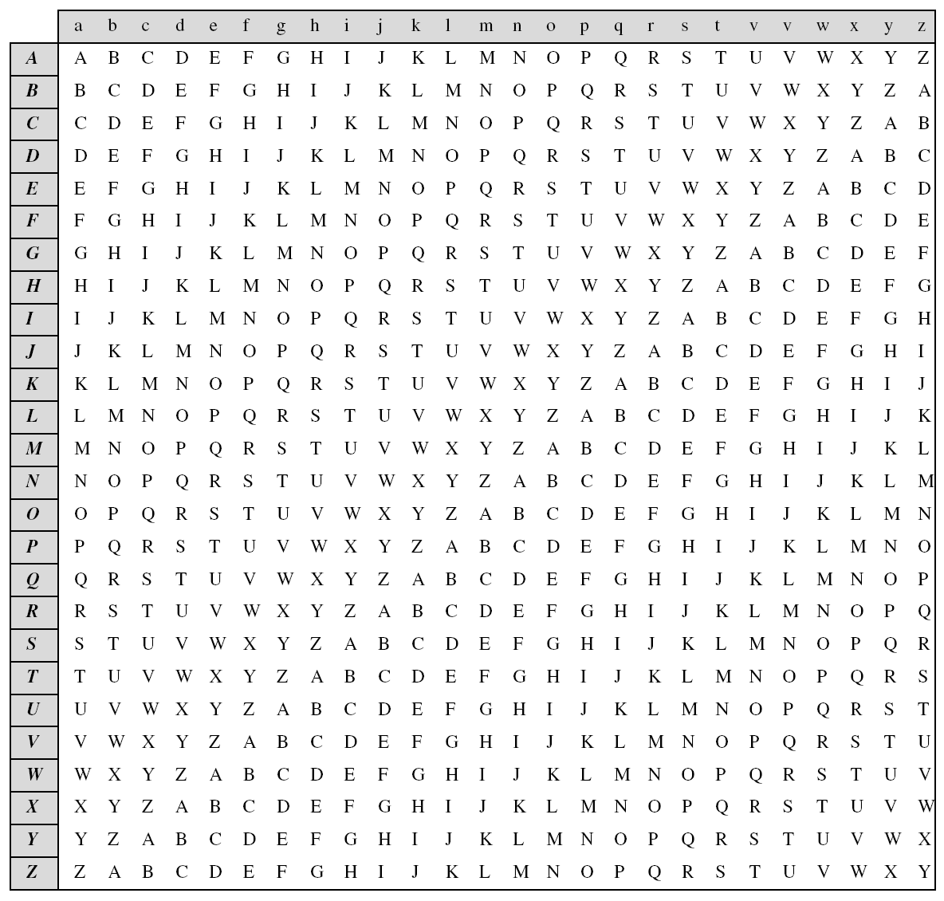
this additive cipher is a special case of Vigenere cipher. Where m=1
plaintext
key
Table 3.3
A Vigenere Tableau
3.<number>

Slide 41
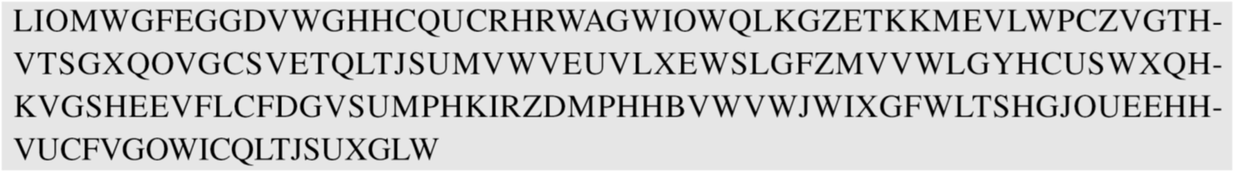
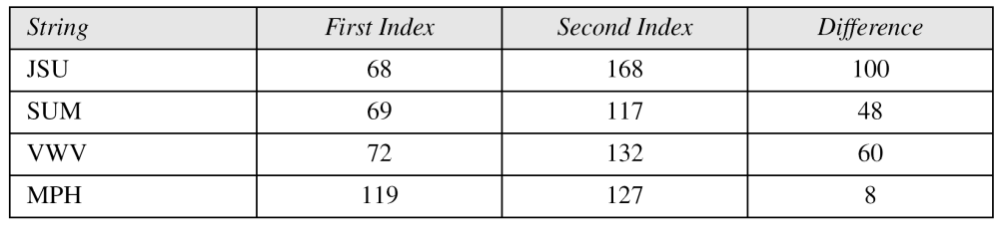
3.2.2 Continued
Vigenere Cipher (Crypanalysis)
Example 3.19
Let us assume we have intercepted the following ciphertext:
The Kasiski test for repetition of three-character segments yields the results shown in Table 3.4.
3.<number>

Slide 42
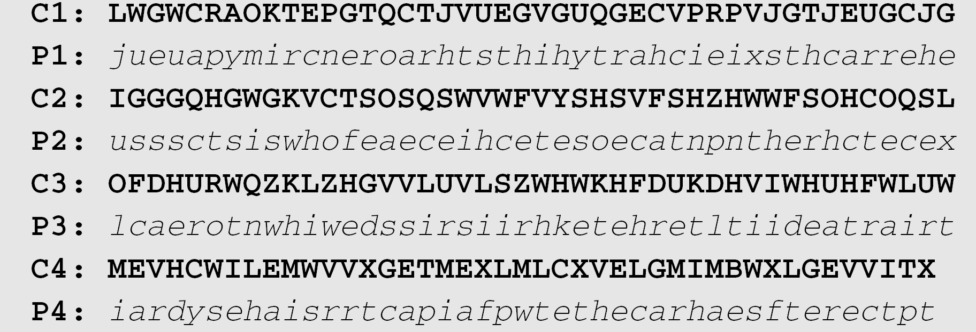
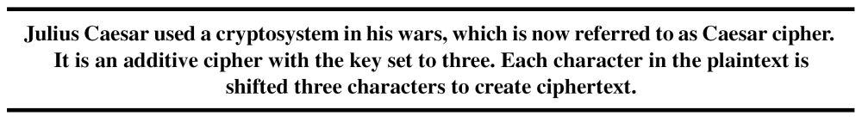
3.2.2 Continued
The greatest common divisor of differences is 4, which means that the key length is multiple of 4. First try m = 4 with frequency analysis.
In this case, the plaintext makes sense.
3.<number>

Slide 43
Example
eg using keyword deceptive
  key: deceptivedeceptivedeceptive
  plaintext: wearediscoveredsaveyourself
  ciphertext:ZICVTWQNGRZGVTWAVZHCQYGLMGJ
string | 1st index | 2nd index | difference
VTW | 4 | 13 | 9
suggests keyword size of 3 or 9
then attack each monoalphabetic cipher individually using previous techniques
3.<number>

Slide 44
3.2.2 Continued
One-Time Pad
if a truly random key as long as the message is used, the cipher will be secure
  called a One-Time pad
  is unbreakable since ciphertext bears no statistical relationship to the plaintext
  since for any plaintext & any ciphertext there exists a key mapping one to other
  can only use the key once though
have problem of safe distribution of key
3.<number>

Slide 45
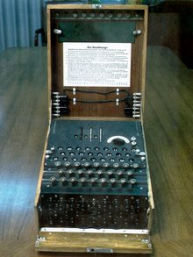
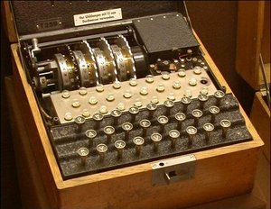
Enigma Machine
Enigma was a portable cipher machine used to encrypt and decrypt secret messages.
  a family of related electro-mechanical rotor machines
Japan commercial
German military

Slide 46
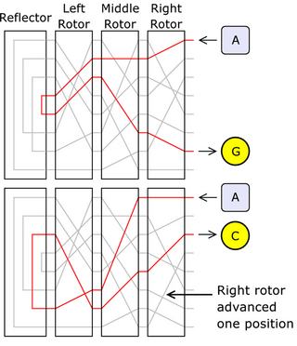
Enigma Machine
  Enigma encryption for two consecutive letters —
  current is passed into set of rotors, around the reflector, and back out through the rotors again.
  Letter A encrypts differently with consecutive key presses, first to G, and then to C. This is because the right hand rotor has stepped, sending the signal on a completely different route.

Slide 47
Enigma
the actual encipherment of a letter is performed electrically.
  When a key is pressed, the circuit is completed; current flows through the various components and ultimately lights one of many lamps, indicating the output letter.
  Current flows from a battery through the switch controlled by the depressed key into a fixed entry wheel. This leads into the rotor assembly (or scrambler), where the complex internal wiring of each rotor results in the current passing from one rotor to the next along a convoluted path. After passing through all the rotors, current enters the reflector, which relays the signal back out again through the rotors and the entry wheel — this time via a different path — and, finally, to one of the lamps (the earliest Enigma models do not have the reflector).

Slide 48
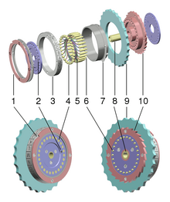
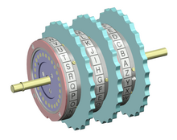
Rotors
performs a very simple type of encryption
  a simple substitution cipher

Slide 49
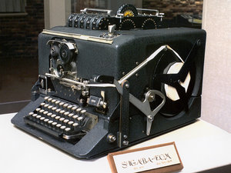
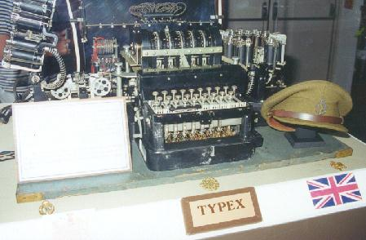
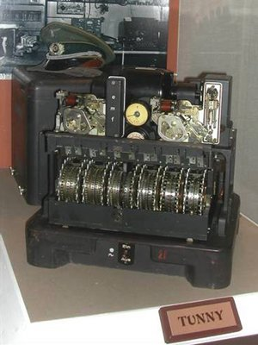
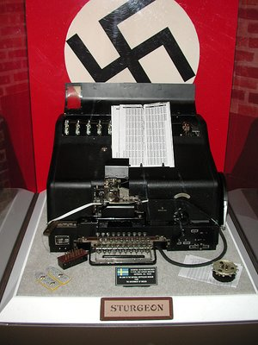
World War II Era Encryption Devices
A few here
  Sigaba (United States)
  Typex (Britain)
  Lorenz cipher (Germany)
For more, see
  http://w1tp.com/enigma/

Slide 50
3-3 TRANSPOSITION CIPHERS
A transposition cipher does not substitute one symbol for another, instead it changes the location of the symbols.
Note
A transposition cipher reorders symbols.
these hide the message by rearranging the letter order
without altering the actual letters used.
Topics discussed in this section:
3.3.1 Keyless Transposition Ciphers
3.3.2 Keyed Transposition Ciphers
3.3.3 Combining Two Approaches
3.<number>

Slide 51
3.3.1 Keyless Transposition Ciphers
Simple transposition ciphers, which were used in the past, are keyless.
Example 3.22
A good example of a keyless cipher using the first method is the rail fence cipher. The ciphertext is created reading the pattern row by row. For example, to send the message “Meet me at the park” to Bob, Alice writes
She then creates the ciphertext “MEMATEAKETETHPR”.
3.<number>

Slide 52
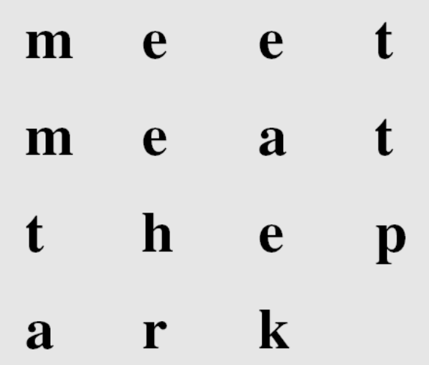
3.3.1 Continued
Example 3.23
Alice and Bob can agree on the number of columns.
Alice writes the same plaintext, row by row, in a table of four columns.
1 2 3 4
She then creates the ciphertext “MMTAEEHREAEKTTP”.
3.<number>

Slide 53
3.3.2 Keyed Transposition Ciphers
The keyless ciphers permute the characters
  by writing plaintext in one way and reading it in another way.
The permutation is done on the whole plaintext to create the whole ciphertext.
Another method is to divide the plaintext into groups of predetermined size, called blocks, and then use a key to permute the characters in each block separately.
3.<number>

Slide 54
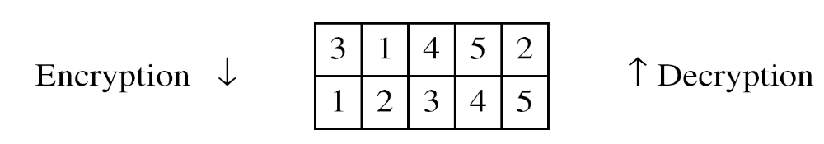
3.3.2 Continued
Example 3.25
Alice needs to send the message “Enemy attacks tonight” to Bob..
The key used for encryption and decryption is a permutation key, which shows how the character are permuted.
The permutation yields
3.<number>

Slide 55
PLAINTEXT:
key
1 4 5 2
1 2 3 4 5
e n e m y
a t t a c
k s t o n
i g h t z
CIPHERTEXT:
3.<number>

Slide 56
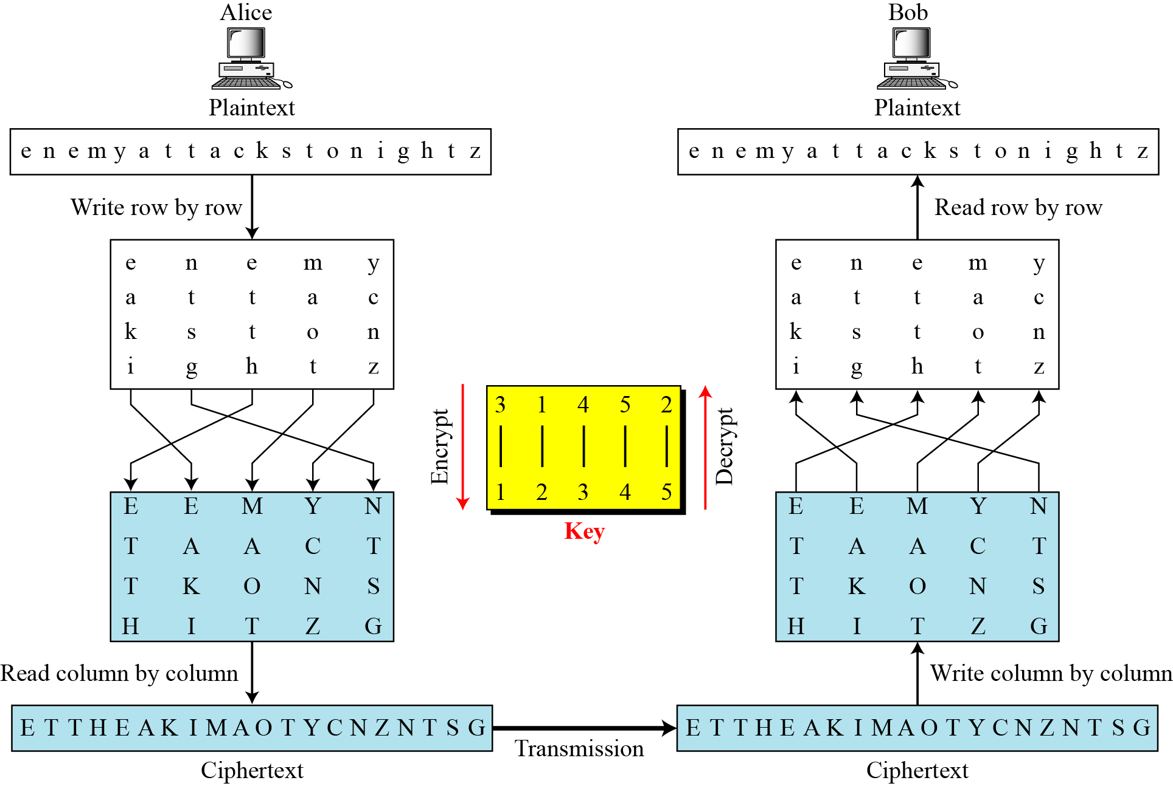
3.3.3 Combining Two Approaches
Example 3.26
Figure 3.21
3.<number>

Slide 57
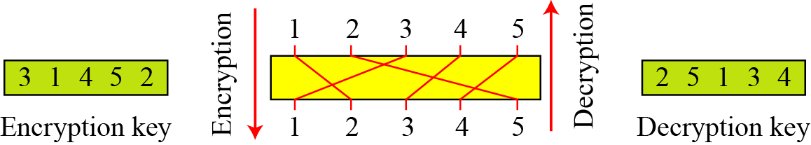
3.3.3 Continued
Keys
In Example 3.27, a single key was used in two directions for the column exchange: downward for encryption, upward for decryption. It is customary to create two keys.
Figure 3.22 Encryption/decryption keys in transpositional ciphers
3 1 4 5 2
2 5 1 3 4
3.<number>

Slide 58
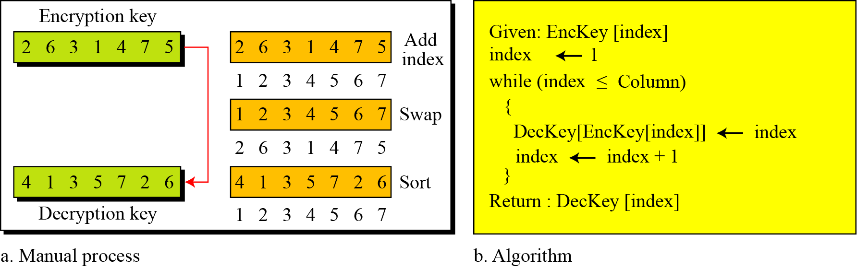
3.3.3 Continued
Figure 3.23 Key inversion in a transposition cipher
3.<number>

Slide 59
Key inversion in a transposition cipher
2 | 6 | 3 | 1 | 4 | 7 | 5
1 | 2 | 3 | 4 | 5 | 6 | 7
1 | 2 | 3 | 4 | 5 | 6 | 7
4 | 1 | 3 | 5 | 7 | 2 | 6
3.<number>

Slide 60
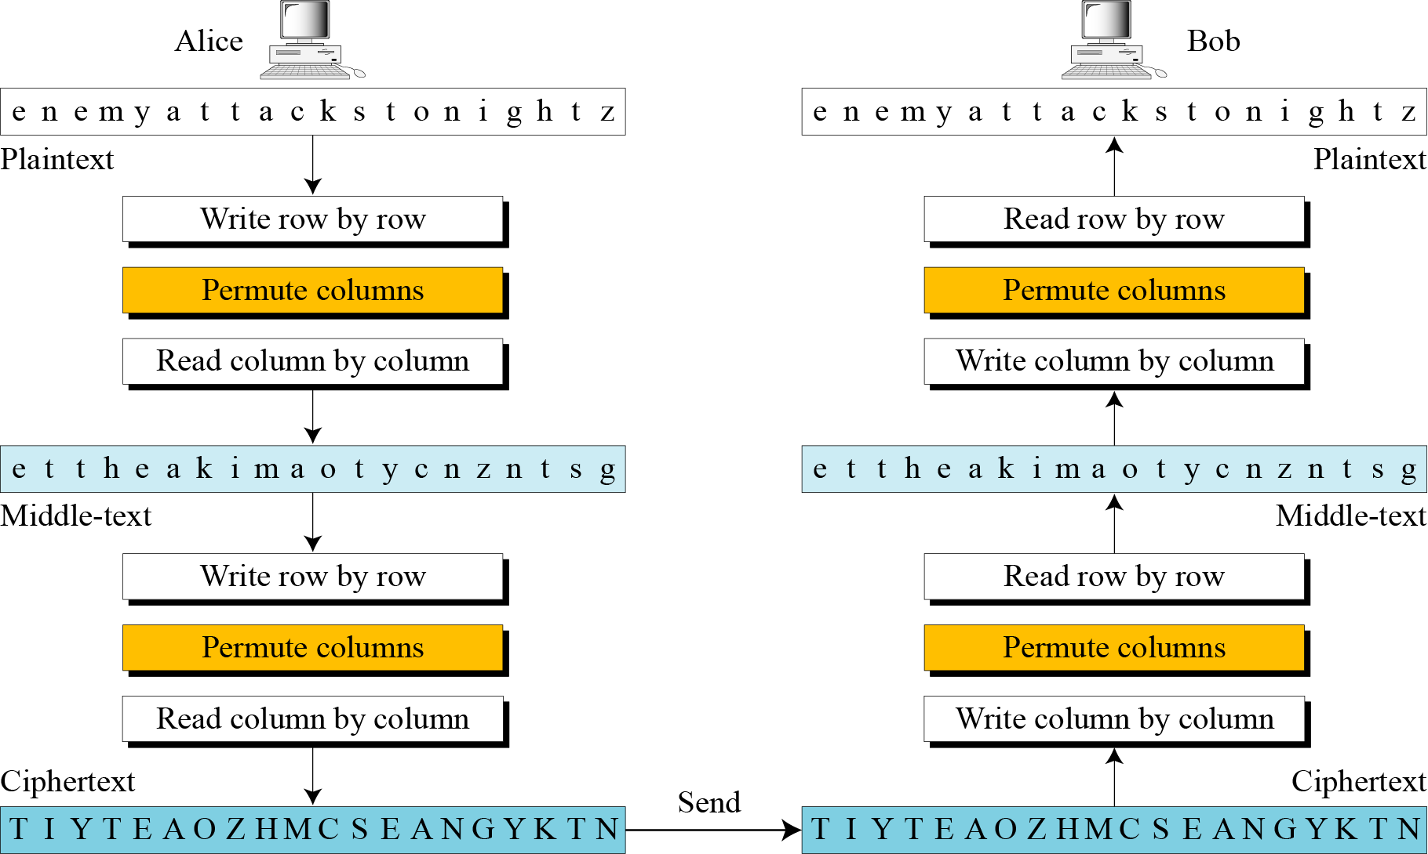
3.3.3 Continued
Double Transposition Ciphers
Figure 3.25 Double transposition cipher
3.<number>

Slide 61
Double Transposition Ciphers (Ex:)
3 1 4 5 2
e n e m y
a t t a c
k s t o n
i g h t z
1 4 5 2
e e m y n
t a a c t
t k o n s
h i t z g
CT1= ettheakimaotycnzntsg
1 4 5 2
t e h e t
i a m a k
y o c n t
t z s g n
1 4 5 2
e t t h e
a k i m a
o t y c n
z n t s g
CT2= tiyteaozhmcseangtktn
3.<number>

Slide 62
Product Ciphers
ciphers using substitutions or transpositions are not secure because of language characteristics
hence consider using several ciphers in succession to make harder, but:
  two substitutions make a more complex substitution
  two transpositions make more complex transposition
  but a substitution followed by a transposition makes a new much harder cipher
this is bridge from classical to modern ciphers
3.<number>

Slide 63
Modern Block Ciphers
will now look at modern block ciphers
provide secrecy and/or authentication services
in particular will introduce DES (Data Encryption Standard)
Notes:
Modern block ciphers are widely used to provide encryption of quantities of information, and/or a cryptographic checksum to ensure the contents have not been altered. We continue to use block ciphers because they are comparatively fast, and because we know a fair amount about how to design them.

Slide 64
Block vs. Stream Ciphers
block ciphers process messages in into blocks, each of which is then en/decrypted
like a substitution on very big characters
  64-bits or more
stream ciphers process messages a bit or byte at a time when en/decrypting
many current ciphers are block ciphers
Notes:
Block ciphers work a on block / word at a time, which is some number of bits. All of these bits have to be available before the block can be processed. Stream ciphers work on a bit or byte of the message at a time, hence process it as a “stream”.

Slide 65
Block Cipher Principles
most symmetric block ciphers are based on a Feistel Cipher Structure
block ciphers look like an extremely large substitution
would need table of 2⁶⁴ entries for a 64-bit block
using idea of a product cipher
Notes:
An arbitrary reversible substitution cipher for a large block size is not practical, however, from an implementation and performance point of view. In general, for an n-bit general substitution block cipher, the size of the key is n x 2^{n}. For a 64-bit block, which is a desirable length to thwart statistical attacks, the key size is 64 x 2⁶⁴ = 2⁷⁰ = 10²¹ bits.

Slide 66
Claude Shannon and
Substitution-Permutation Ciphers
in 1949 Claude Shannon introduced idea of substitution-permutation (S-P) networks
  modern substitution-transposition product cipher
these form the basis of modern block ciphers
S-P networks are based on the two primitive cryptographic operations we have seen before:
  substitution (S-box)
  permutation (P-box)
provide confusion and diffusion of message
Notes:
Claude Shannon’s 1949 paper has the key ideas that led to the development of modern block ciphers. Critically, it was the technique of layering groups of S-boxes separated by a larger P-box to form the S-P network, a complex form of a product cipher. He also introduced the ideas of confusion and diffusion, notionally provided by S-boxes and P-boxes (in conjunction with S-boxes).

Slide 67
Feistel Cipher Structure
Horst Feistel devised the feistel cipher
  based on concept of invertible product cipher
partitions input block into two halves
  process through multiple rounds which
  perform a substitution on left data half
  based on round function of right half & subkey
  then have permutation swapping halves
implements Shannon’s substitution-permutation network concept
Notes:
Horst Feistel, working at IBM Thomas J Watson Research Labs devised a suitable invertible cipher structure in early 70's.
One of Feistel's main contributions was the invention of a suitable structure which adapted Shannon's S-P network in an easily inverted structure. Essentially the same h/w or s/w is used for both encryption and decryption, with just a slight change in how the keys are used. One layer of S-boxes and the following P-box are used to form the round function.

Slide 68
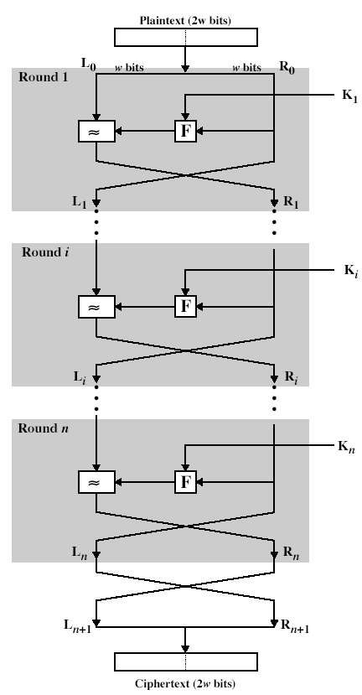
Feistel Cipher Structure

Slide 69
Feistel Cipher Design Principles
block size
  increasing size improves security, but slows cipher
key size
  increasing size improves security, makes exhaustive key searching harder, but may slow cipher
number of rounds
  increasing number improves security, but slows cipher
subkey generation
  greater complexity can make analysis harder, but slows cipher
round function
  greater complexity can make analysis harder, but slows cipher
fast software en/decryption & ease of analysis
  are more recent concerns for practical use and testing

Slide 70
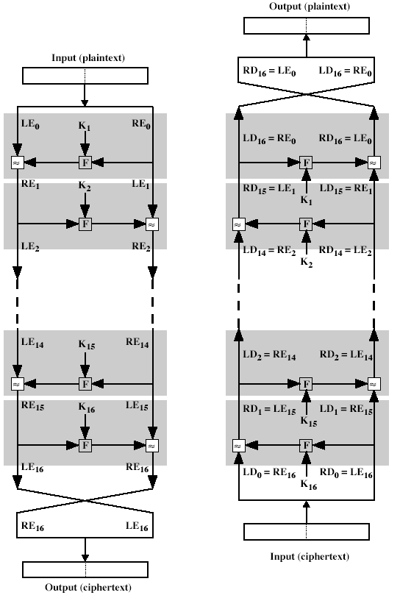
Feistel Cipher Decryption
Notes:
The process of decryption with a Feistel cipher is essentially the same as the encryption process. The rule is as follows: Use the ciphertext as input to the algorithm, but use the subkeys Ki in reverse order. That is, use Kn in the first round, Kn–1 in the second round, and so on until K1 is used in the last round. This is a nice feature because it means we need not implement two different algorithms, one for encryption and one for decryption.

